Slide 1
Finding Persistent Items in Data Streams
Haipeng Dai¹, Muhammad Shahzad², Alex X. Liu¹, Yuankun Zhong¹.
¹ State Key Laboratory for Novel Software Technology,
Nanjing University, China.
² North Carolina State University, USA.
Notes:
Good morning, everyone. My name is Haipeng Dai, I come from Nanjing University in China. It’s a great honor for me to give a presentation in VLDB 2017. The title of my paper is “Finding Persistent Items in Data Streams”, this is a joint work with Muhammad Shahzad, Alex Liu, and Yuankun Zhong.

Slide 2
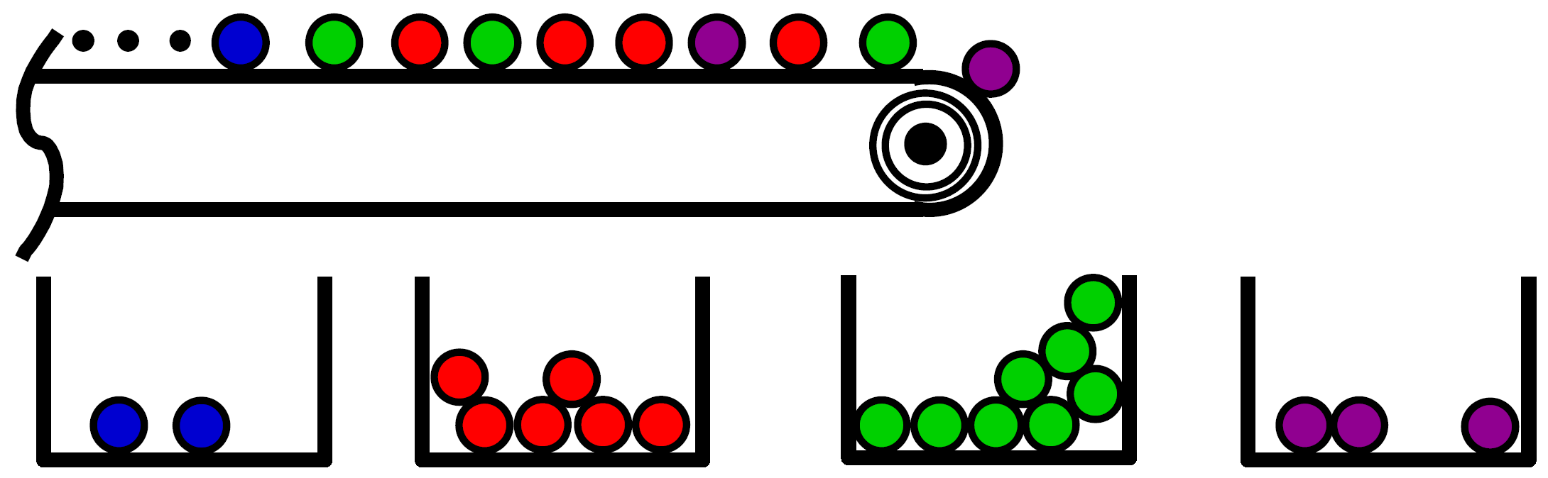
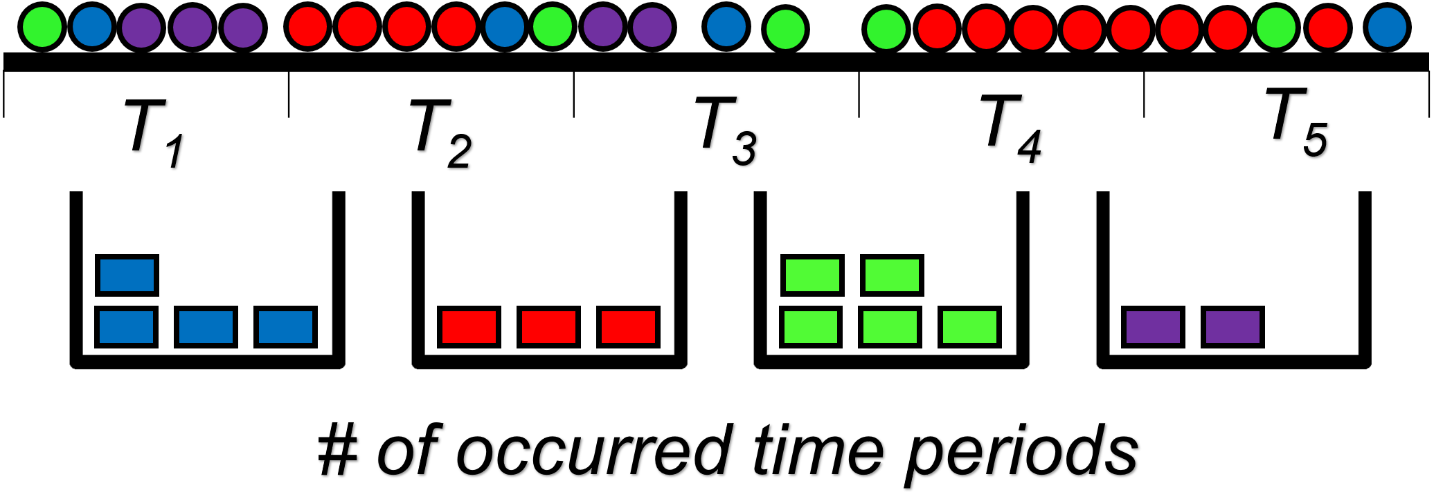
Frequent Item vs. Persistent Item
Given a stream of N items, find those that occur most frequently.
Frequent Item
Persistent Item
Given a stream in T consecutive equally sized measurement periods, find those items that occur in most measurement periods (≥ a threshold T_{th}).
Notes:
First of all, let’s review the traditional problem of frequent item identification. Given a stream of N items, the frequent item identification problem is to find those items that occur most frequently.
In our work, we study the so-called persistent item identification problem. The problem is shown in this slide: Given a stream in T consecutive equally sized measurement periods, find those items that occur in most measurement periods, that is, occur in more than a threshold T_th periods.

Slide 3


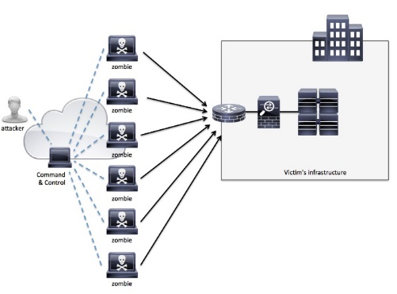

Potential Applications for Persistent Items Identification
Stealthy DDoS attacks
Stealthy port scanning attacks
Communication between a bot and its C&C server
Click-fraud detection
Notes:
In this slide, we envision some Potential Applications for Persistent Items Identification.
For example, it can be used to detect stealthy DDoS attacks. In this case, an attacker does not overwhelm the target with a large number of flows, but rather, it degrades the performance of the target using a small number of flows for a long period of time.
Similarly, it can be used to detect stealthy port scanning attacks, where an attacker uses a small probing rate for a long period of time to discover system vulnerabilities.
Persistent item Identification can also be used to detect network bots by monitoring the communication between a bot and its C&C server [13].
Further, for click-fraud detection, it can be used to detect if automatic robots are periodically generating clicks on an ad to increase the payment for an advertiser in pay-per-click online advertising systems.
The common feature of these applications is that the aggregate occurrences of the considered events are so few that traditional frequent items identification schemes cannot detect them, but persistent items identification can.

Slide 4
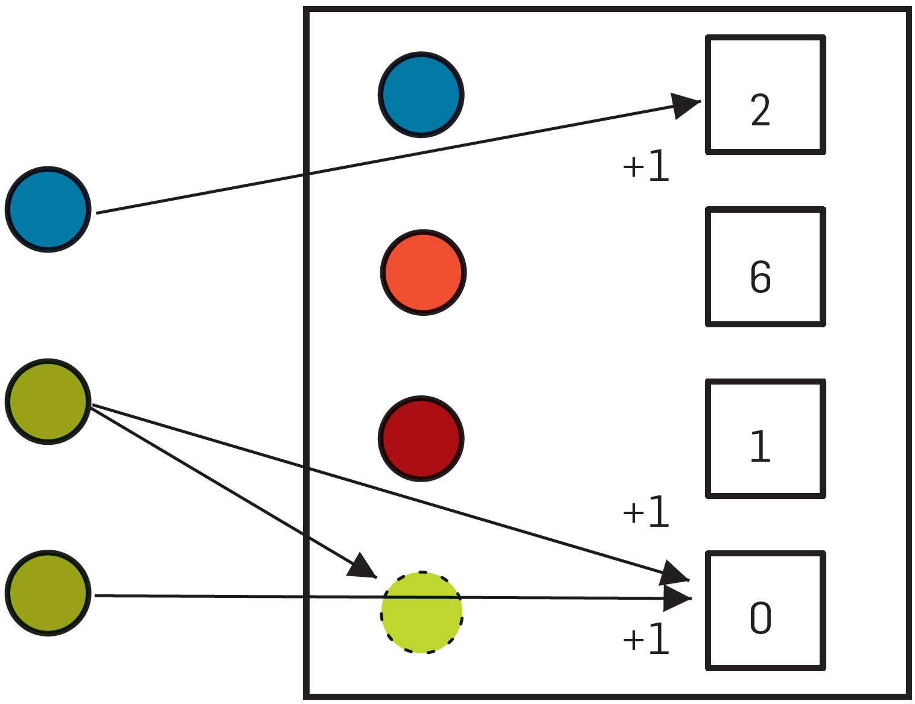
Limitations of Prior Art
Prior Approach 1: Counter-based Algorithms
Lossy Counting [Manku et al VLDB 2002]
Space Saving [Metwally et al Database Theory-ICDT 2005]
Limitations: low memory efficiency; cannot eliminate duplicate items within a measurement period
Notes:
Before introducing our scheme, we first discuss the limitations of prior art for frequent item identification. Basically, the existing approaches to frequent item identification can be classified into 3 categories.
The first category is Counter-based Algorithms such as Lossy couting and space saving. For these algorithms, they need to maintain the whole ID information for each item. The limitations of these approaches are low memory efficiency; and that they cannot eliminate duplicate items within a measurement period.
For example, the space saving algorithm proposed in 2005 works as follows. It stores k pairs of item ID and count value. For each incoming item, it first checks if the item matches an item in one of the k pairs, if so, it increments the count in the corresponding pair by one. Otherwise, it replaces the pair with the smallest count value by a new pair, which contains the incoming item and the count equal to the smallest count value incremented by one.
For the example shown in this slide, first, the blue item is already stored, so its count is incremented when it is seen. The green (middle) item takes up the counter with least value, then a second occurrence increments it.
assigns one BF per set, for example, BF1 for S1, BF2 for S2, and BFN for SN. And record all elements belonging to the same set in the corresponding BF. The query process is very simple, just sequentially check each Bloom filter to determine which set a given element belongs to. Apparently, the query complexity for this approach is given by (# of hash functions in a Bloom filter) X (# of sets).

Slide 5
Limitations of Prior Art
Prior Approach 2: Sketch-based Algorithms
C-sketch [Charikar et al Automata, Languages and Programming 2002]
CM-sketch [Cormode et al Journal of Algorithms 2005]
Limitations: low memory efficiency; cannot eliminate duplicate items within a measurement period
h₁(k)
…
0
1
K-1
1
+C_{t}
…
h_{j}(k)
j
Key _{t}
+C_{t}
…
h_{H}(k)
H
+C_{t}
Notes:
The second category are sketch-based algorithms, such as C-sketch and CM-sketch. These approaches maintain an 2D array of counters, and when an new item comes, they map the item using hash functions to a position in each row, and modify the value of the counter there accordingly. Besides, these algorithms also need to record the ID information for frequent items. The limitations of these approaches are still low memory efficiency and they unable to eliminate duplicate items within a measurement period.

Slide 6
Limitations of Prior Art
Prior Approach 3: Invertible Bloom Filter
IBF [Eppstein et al SIGCOMM 2011]: store set ID and auxiliary info.
Limitations: low memory efficiency; cannot eliminate duplicate items within a measurement period
A
B
C
Hash1
Hash2
Hash3
idSum ⊕ A
hashSum ⊕ H(A)
count++
idSum ⊕ A
hashSum ⊕ H(A)
count++
idSum ⊕ A
hashSum ⊕ H(A)
count++
IBF:
Notes:
The third category includes one single approach, invertible bloom filter proposed in SIGCOMM 2011. It stores set ID and some other auxiliary information in each cell. The auxiliary information helps to determine whether the cell is collided. IBF has also same limitations as the algorithms in the first two categories.
An invertible Bloom filter (IBF) is similar to a conventional Bloom filter except that it can be inverted to yield the IDs of some of the inserted items. An IBF contains an array of cells, which in turn contains three fields: idSum, hashSum, and count. For any incoming item, the item is mapped into several cells using hash functions. For each cell that the item is mapped to, the count is incremented by 1, the stored idSum is XORed with the item ID, and the stored hashSum is XORed with the hash of the item ID. In the decoding phase, the “pure” cells, i.e., the cells with count field either 1 or −1, are first identified
and the item IDs from them are recovered. Using the IDs recovered from these pure cells, IBF further decodes the IDs from other cells to which the recovered IDs were mapped
to. Note that, IBF can not always decode all IDs, i.e., it has false negatives. IBF can be adapted for identifying persistent items by assigning one IBF to each measurement period and maintaining an additional Bloom filter as described earlier in Section 6.1. Unfortunately, this adapted IBF scheme has a very low memory efficiency because it needs to store the whole ID information for every item during every measurement period, unlike PIE, which stores only a few encoded bits of every ID during any given measurement period in
which the item appeared.

Slide 7
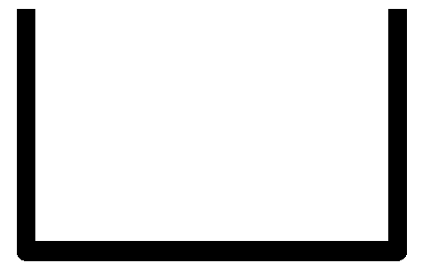

Motivation
A naïve approach for persistent items identification
T₁
T₂
T₃
T₄
T₅
Remove Duplicate
Data
Structure (Store Whole ID Information)
Memory inefficiency!
Store whole IDs for persistent/non-persistent items many times, but only one is needed for each persistent item!
Collect & Analysis
X 4
X 3
X 5
X 2
(T_{th}=4 )
Notes:
Before introducing our solution, we first present a naïve approach for persistent items identification in order to motivate our solution.
We use a simple example for illustration. In this slide, suppose there are 5 measurement periods. For each period, suppose we can remove duplicates of items by some means, and then we record whole ID information for each item in a data structure. And when all measurement periods end, we collect all the instances of such data structure for analysis, and finally find that the item occurrences of blue, red, green, purple items are 4, 3, 5, 2, respectively. If the threshold for persistent items is set to 4, we can find that the blue item and green item are persistent items.

Slide 8
Key Idea of PIE
Our Solution: Persistent items Identification schemE (PIE)
T₁
T₂
T₃
T₄
T₅
Remove Duplicate
Data
Structure (Store Partial ID Information)
Collect & Recover & Analysis
X 4
?
X 5
?
(T_{th}=4 )
Notes:
Now we introduce the key idea of our solution, Persistent items Identification schemE (PIE for short)
Compared with the naïve approach, for each measurement period, we only store partial ID information for each item. Moreover, after collected all instances of recording data structure, we try to recover the original item ID. We set a proper length of stored partial ID information such that IDs of persistent items can be recovered with very high probability while IDs of non-persistent items are not. Though non-persistent items cannot be recovered, it doesn’t matter because we are not interested in them. Overall, this scheme is storage efficient because it only needs store partial ID information of items.

Slide 9
Key Idea of PIE (cont’)
Questions:
How to store and recover ID information?
Encode + Decode
How to pinpoint the stored information for the same item ID in the data structure without the knowledge of the item ID?
Position Info. + Hash-print Info.
Notes:
For PIE, we have two questions. First, How to store and recover ID information? Our solution is using a coding technique to encode and decode item IDs.
Second, How to pinpoint the stored information for the same ID in these data structures without the knowledge of the ID?
Our solution is to use the position information and hash-print information in the data structure for identification. We will introduce them later.
1. encode the ID of each item into a few bits with fixed length during a measurement period, and collect all encoded bits in all measurement periods for a same item for decoding;
2. set the length of encoded bits in each period such that persistent items can be decoded with high probability while non-persistent items not.

Slide 10
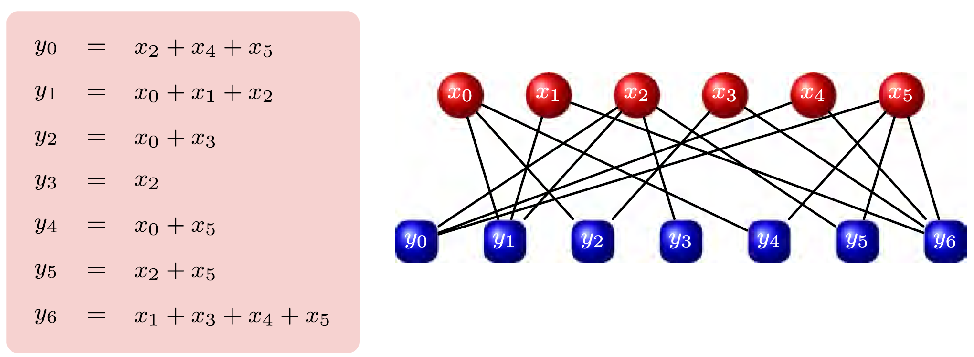
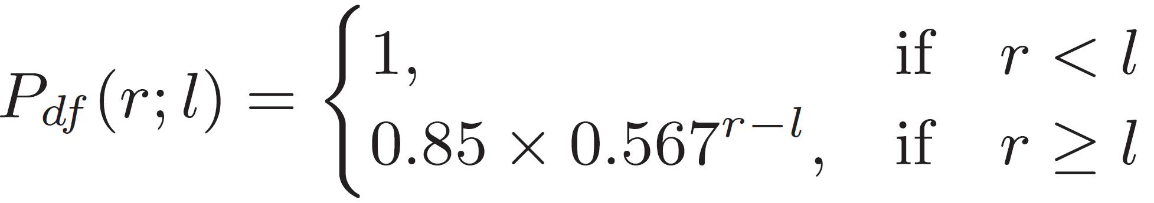
Raptor Codes Introduction
Introduction: encode k symbols into potentially limitless encoding symbols
Advantages:
Linear time encoding and decoding speed
High decoding success probability (or low decoding failure probability)
…
Decoding failure probability
Notes:
In our work, we use Raptor codes for coding and decoding item IDs.
Raptor codes can encode k symbols into potentially limitless encoding symbols, and knowing k or more encoding symbols allows decoding with low failure probability. The top figure in this slide shows that 6 symbols are encoded into 7 encoding symbols, and each encoded symbol is a linear combination of the input 6 symbols.
Raptor codes have many advantages. To name a few, it has linear time encoding and decoding speed, which is quite beneficial in our scenario. It also has high decoding success probability (or low decoding failure probability) if the number of received symbols is larger than k.
This slide shows the mathematical expression for decoding failure probability. We can see that it decreases at an exponential speed given that the number of received symbols r is greater than the length of item ID l.

Slide 11
Space-Time Bloom Filter (STBF)
Structure: an array C_{i} of cells with uniform length
Structure of a cell: (Flag, Raptor codes, Hash-print)
Cell status: empty, singleton, collided
Name (notation) | Length | Description
Flag: C_{iF}[x] | 1 | Indicating whether the cell is empty, singleton, or collided (combined with other bits)
Raptor Codes : C_{iR}[x] | r | Encoded codes for ID recovering, same for all mapped cells for an item in a period, but different for different periods
Hash-print: C_{iP}[x] | p | Fingerprint-like info. generated by hashing for an item, same for all mapped cells in all periods
Notes:
Now we introduce our proposed data structure, Space-Time Bloom Filter (STBF), for recording item IDs. Basically, STBF is adapted from traditional Bloom filters.
STBF consists of an array Ci of cells with uniform length. For each cell, it contains three fields, Flag, Raptor codes, and Hash-print. The length and description of these three fields are shown in this table. In particular, the flag field has length of 1, and it indicates whether the cell is empty or not. The Raptor codes filed stores encoded codes for ID recovering, and it is same for all mapped cells for an item in a measurement period, but different for different periods. The hash-print filed stores fingerprint-like info. generated by hashing for an item, it is the same for all cells and all periods.
Besides, there are three cell status: empty, singleton, and collided.

Slide 12
Recording Phase of STBF
E.g.:
000000
000000
000000
000000
000000
000000
empty
empty
empty
empty
empty
empty
Notes:
We use an example to show the recording phase of STBF in a measurement period.
At the very beginning, all cells in a STBF are empty, and their stored bits are all 0.

Slide 13
Recording Phase of STBF
E.g.:
e₁
h₁(e₁)%m
h₃(e₁)%m
h₂(e₁)%m
1 || C_{iR}[x₁] || C_{iP}[x₁]
000000
1 || C_{iR}[x₃] || C_{iR}[x₃]
1 || C_{iR}[x₄] || C_{iR}[x₄]
000000
000000
singleton
singleton
singleton
Notes:
Then, an item e1 comes, it is mapped to k cells using k different hash functions. The STBF set the flags in these cells to 1, and store Raptor codes and hash-print information. The status of the first, third, fourth cells becomes singleton.

Slide 14
Recording Phase of STBF
E.g.:
e₂
h₁(e₂)%m
h₂(e₂)%m
h₃(e₂)%m
1 || C_{iR}[x₁] || C_{iP}[x₁]
000000
1 || C_{iR}[x₃] || C_{iR}[x₃]
011111
1 || C_{iR}[x₅] ||
C_{iP}[x₅]
1 || C_{iR}[x₆] ||
C_{iP}[x₆]
collided
singleton
singleton
Notes:
Next, a different item e2 comes, it is also mapped to 3 cells. The fourth cell is then becomes collided, then the flag is set to 0 while the left bits in the cell are set to 1.

Slide 15
Recording Phase of STBF
E.g.:
e₁
duplicate
h₁(e₁)%m
h₃(e₁)%m
h₂(e₁)%m
1 || C_{iR}[x₁] || C_{iP}[x₁]
000000
1 || C_{iR}[x₃] || C_{iR}[x₃]
011111
1 || C_{iR}[x₅] ||
C_{iP}[x₅]
1 || C_{iR}[x₆] ||
C_{iP}[x₆]
Notes:
Further, a new instance of item e1 comes. For this case, we can identify that it is a duplicate by checking the stored information of mapped cells that are not collided.

Slide 16
Identification Phase of STBF
Process cell lines one by one, cluster stored Raptor codes into different groups in terms of cell lines and hash-prints, then decode codes in the same group
STBF 1
STBF 2
STBF 3
STBF 4
STBF 5
STBF 6
cell line 1 with 1 group
Notes:
For the identification phase of STBF, we collect all STBFs for all measurement periods, and put them in a vertical order as shown in this slide. We say all cells lying in the same column form a cell line. Then we process cell lines one by one, cluster stored Raptor codes into different groups in terms of cell lines and hash-prints, then decode codes in the same group into an item ID.
For the example in the slide, we collect 6 STBFs, and process cell line 1 and obtain a group.

Slide 17
Identification Phase of STBF
Process cell lines one by one, cluster stored Raptor codes into different groups in terms of cell lines and hash-prints, then decode codes in the same group
STBF 1
STBF 2
STBF 3
STBF 4
STBF 5
STBF 6
cell line 4 with 1 group
Notes:
Then, we continue processing cell lines in order, but get none until cell line 4, and obtain 1 group.

Slide 18
Identification Phase of STBF
Process cell lines one by one, cluster stored Raptor codes into different groups in terms of cell lines and hash-prints, then decode codes in the same group
STBF 1
STBF 2
STBF 3
STBF 4
STBF 5
STBF 6
cell line 5 with 1 group
Notes:
Next, we process cell line 5 and obtain 1 more group.

Slide 19
Identification Phase of STBF
Process cell lines one by one, cluster stored Raptor codes into different groups in terms of cell lines and hash-prints, then decode codes in the same group
STBF 1
STBF 2
STBF 3
STBF 4
STBF 5
STBF 6
cell line 7 with 3 groups
Notes:
And cell line 7, 3 groups.

Slide 20
Identification Phase of STBF
Process cell lines one by one, cluster stored Raptor codes into different groups in terms of cell lines and hash-prints, then decode codes in the same group
STBF 1
STBF 2
STBF 3
STBF 4
STBF 5
STBF 6
cell line 8 with 1 group
Notes:
And so on.

Slide 21
Identification Phase of STBF
Process cell lines one by one, cluster stored Raptor codes into different groups in terms of cell lines and hash-prints, then decode codes in the same group
STBF 1
STBF 2
STBF 3
STBF 4
STBF 5
STBF 6
cell line 9 with 1 group

Slide 22
Identification Phase of STBF
Process cell lines one by one, cluster stored Raptor codes into different groups in terms of cell lines and hash-prints, then decode codes in the same group
STBF 1
STBF 2
STBF 3
STBF 4
STBF 5
STBF 6
cell line 10 with 1 group
Notes:
Until we reach the end of the STBFs.

Slide 23
Performance Analysis - FNR
False Negative Rate (FNR): the rate of failing to recover the IDs of persistent items
Two possible cases for FNR:
Hash-mapping Collision: one or more cells are collided and the Raptor codes are lost
→ easy to analyze
Hash-print Collision: some other items happen to have the same hash-prints with the considered persistent item, and their introduced Raptor codes make the recovering fail
→ hard to analyze
Notes:
Now we analyze the performance of PIE.
We first analyze the false negative rate, FNR for short, that is, the rate of failing to recover the IDs of persistent items.
Particularly, we need to analyze the probabilities of two possible cases that lead to false negative.
The first is Hash-mapping Collisions. It happens when one or more cells are collided and the Raptor codes are lost. This case is easy to analyze and we omit it here to save time.
The second is Hash-print Collisions. It refers to the case that some other items happen to have the same hash-prints with the considered persistent item, and their introduced Raptor codes make the recovering fail. Unlike the first case, this case is pretty hard to analyze.

Slide 24
Performance Analysis – FNR (cont’)
Hash-print Collision analysis for FNR: need to enumerate all possibilities of collisions
E.g.:
1 cell hash-print collision
(1 )
or
(1 )
or
(1 )
2 cell hash-print collision
(2 )
or
(2 )
or
(2 )
or
(1 +1 )
or
(1 +1 )
……
……
Notes:
The hardness of analyzing the hash-print Collison case stems from the need to enumerate all combinations of collisions.
For example, when we analyze 1 cell hash-print collision for the blue item, we need to enumerate all possibilities, suppose there are other three items, red item, green item, purple item. Then it is possible that the hash-print collision is caused by 1 red item, or 1 green item, or 1 purple item.
When for 2 cell hash-print collision, the case is much more complicated, as we can see, the collision may be caused by 2 red items, or 2 green items, or 2 purple items, and even 1 red item plus 1 green item, 1 red item plus 1 purple item. The case is even more complicated for hash-print collision involved more cells.

Slide 25
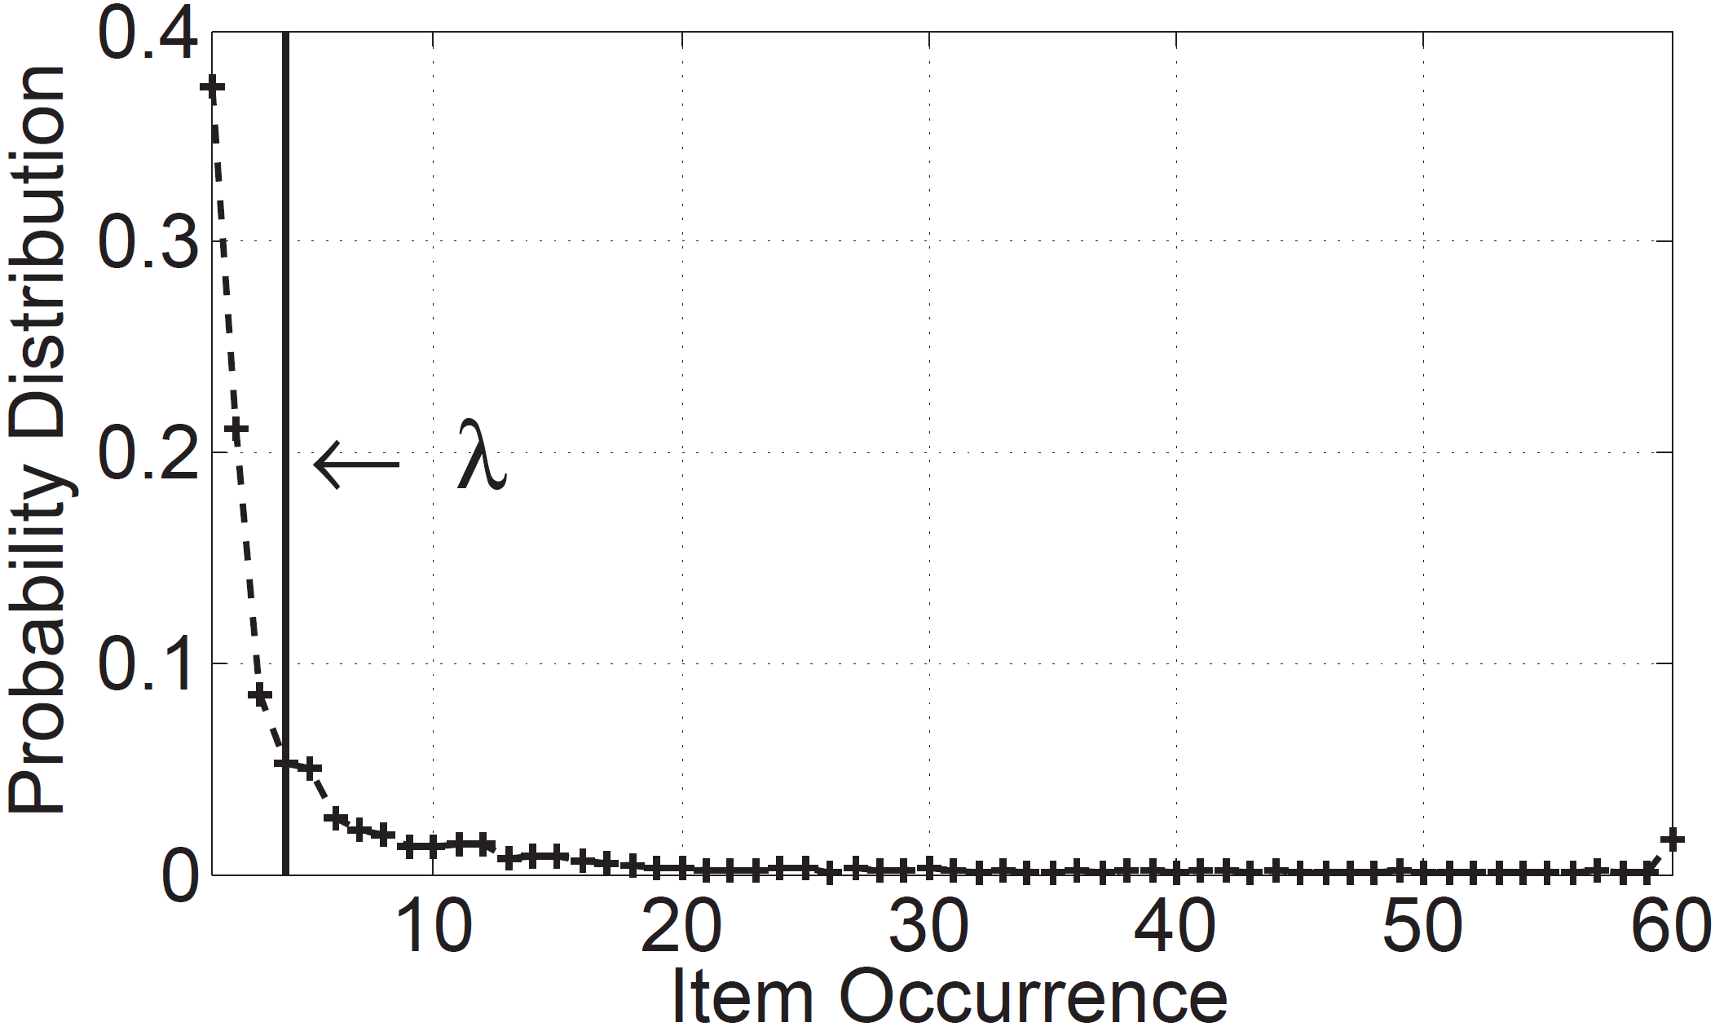
Performance Analysis – FNR (cont’)
Our solution: two-partite approximation
Observation: distributions of item occurrences in practical applications typically follows Zipf or “Zipf-like” skewed distribution
Item occurrences ≈ 1
Item occurrences ≈ sufficiently large to cause recovering failure
Analysis based on binomial distribution
Analysis based on geometric distribution
Notes:
To address this problem, we propose a two-partite approximation method. The motivation of this method is that we observe that the distributions of item occurrences in practical applications typically follows Zipf or “Zipf-like” skewed distribution.
Therefore, we choose an appropriate value \lambda of item occurrences, and on one hand, approximate the item occurrences for items with occurrences less than \lambda as 1, and then we can do analysis based on binomial distribution. On the other hand, we approximate the item occurrences for items with occurrences greater than \lambda as being sufficiently large to cause recover failure, and then do analysis based on geometric distribution.
Then, by considering these two cases, we can obtain the probability for hash-print collision.

Slide 26
Performance Analysis - FPR
False Positive Rate (FPR): the rate of wrongly recovering the IDs of non-persistent items
Two possible cases for FPR:
Phantom items: the recovered ID does not actually belong to any of the observed items during T measurement periods
Non-persistent items: the recovered ID is exactly the same as some other non-persistent item
We derive an upper bound for FPR considering both cases
Notes:
We also analyze the False Positive Rate, FPR for short, for PIE, the rate of wrongly recovering the IDs of non-persistent items.
There are also two possible cases for FPR. First, the recovered persistent items may be phantom items, that is, the recovered ID does not actually belong to any of the observed items during the T periods. Second, the recovered items may be Non-persistent items, which means the recovered ID is exactly the same as some other non-persistent item.
We derive an upper bound for FPR considering both cases.

Slide 27
Parameter Optimization for FNR
Challenges:
Complicated mathematical expression of FNR
Optimization with three parameters (r, p, and m)
Solutions:
Propose an approximation method to simplify the expression of FNR
Find the condition under which FNR is minimized if any parameter out of r, p, and m is fixed, and therefore, simplify the optimization
Notes:
Next, we consider parameter optimization for FNR.
Generally, we faced two challenges: first, the mathematical expression of FNR is very complicated; second, the optimization for FNR involves three parameters, r, p, and m (m is the number of cells in a STBF).
Two address these two challenges, we first propose an approximation method to simplify the expression of FNR, then, we find the condition under which FNR is minimized if any one of r, p, and m is fixed, and therefore, we add this condition into the optimization formulation and simplify the optimization process.

Slide 28
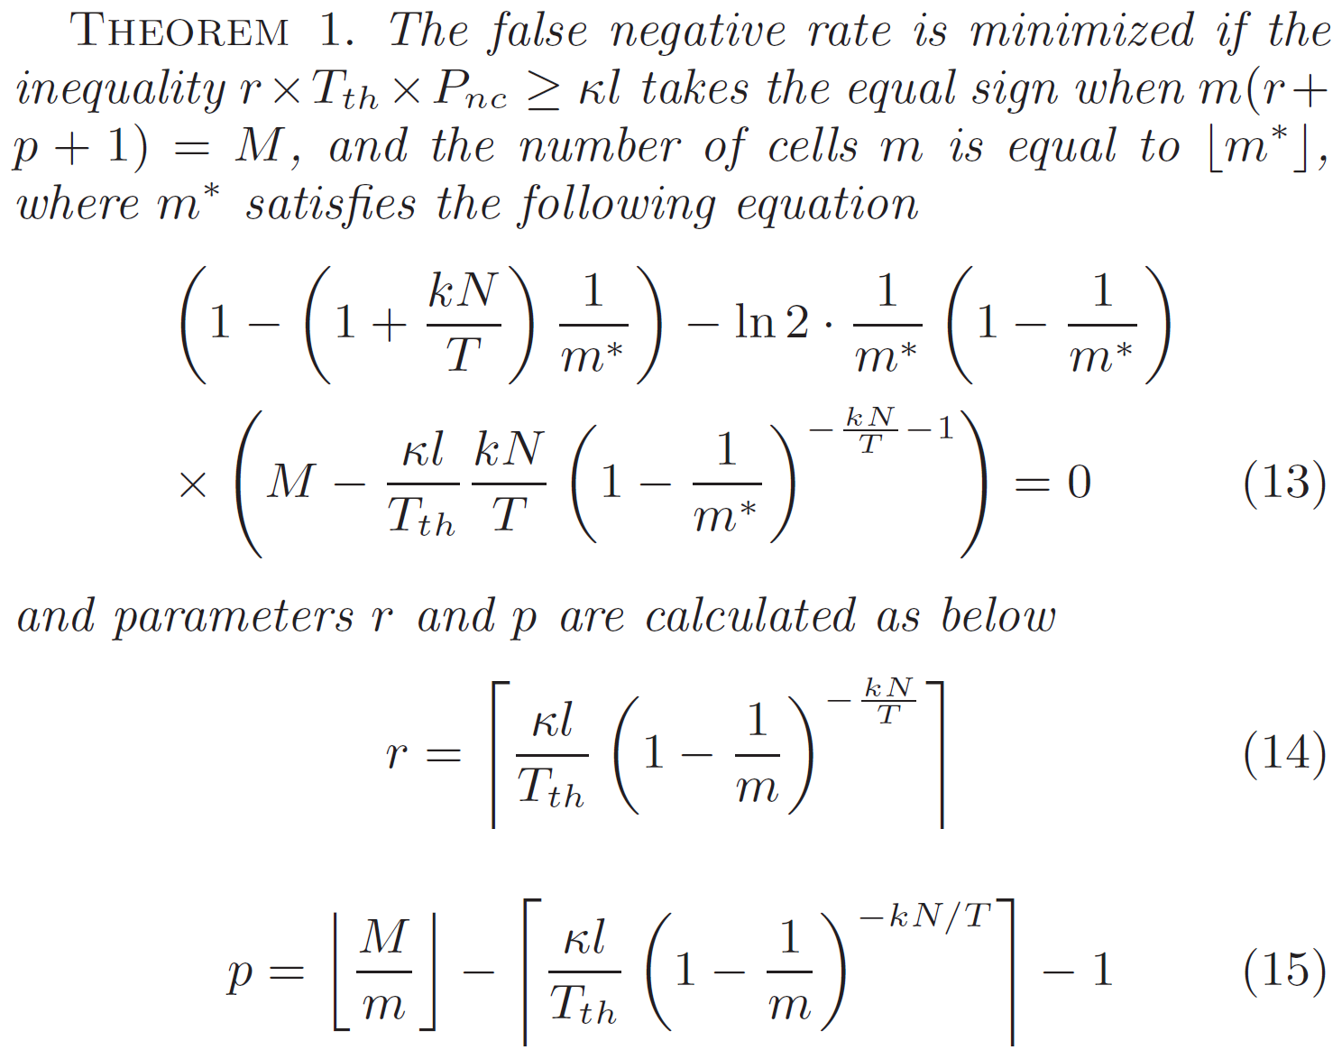
Parameter Optimization for FNR (cont’)
Notes:
This theorem shows the optimization results. Though the expressions for m, r, p are complicated, it is easy to calculate their values by using numerical methods.

Slide 29
Evaluation Setup
Item Traces:
CHIC: a backbone header trace
ICSI: an enterprise network traffic trace
DC: a data center traffic trace collected at a university data center
Trace | Duration | # pkts | # flows
CHIC | 6 min | 25.3 M | 101374
ICSI | 1 hour | 1.49 M | 8797
DC | 1 hour | 8.09 M | 10289
Notes:
Now comes the evaluations.
We use three item traces for evaluation. The first is CHIC, a backbone header trace. The second is ICSI: an enterprise network traffic trace. The third is DC: a data center traffic trace collected at a university data center. As the table shows, each trace includes more than 1 million packets and around 10,000 flows.

Slide 30
Evaluation Setup (cont')
Parameter Settings:
# of measurement periods T : 60
# of mapping hash functions k : 3
Mingling threshold g_{T} : 4
Memory for STBF M : 600Kb (CHIC), 100Kb (ICSI), 300 Kb (DC)
Evaluation metrics: False Negative Rate, False Positive Rate
Side-by-side comparison: CM sketch, IBF
Notes:
We adopt the following parameter settings including number of measurement periods T, number of mapping hash functions k for STBF, and so on. Moreover, we focus on two evaluation metrics, False Negative Rate and False Positive Rate.
Throughout the evaluations, we make side-by-side comparison with two adapted algorithms based on CM sketch and IBF. To be specific, we adapt these two algorithms such that they can remove duplicates items during a measurement period.

Slide 31
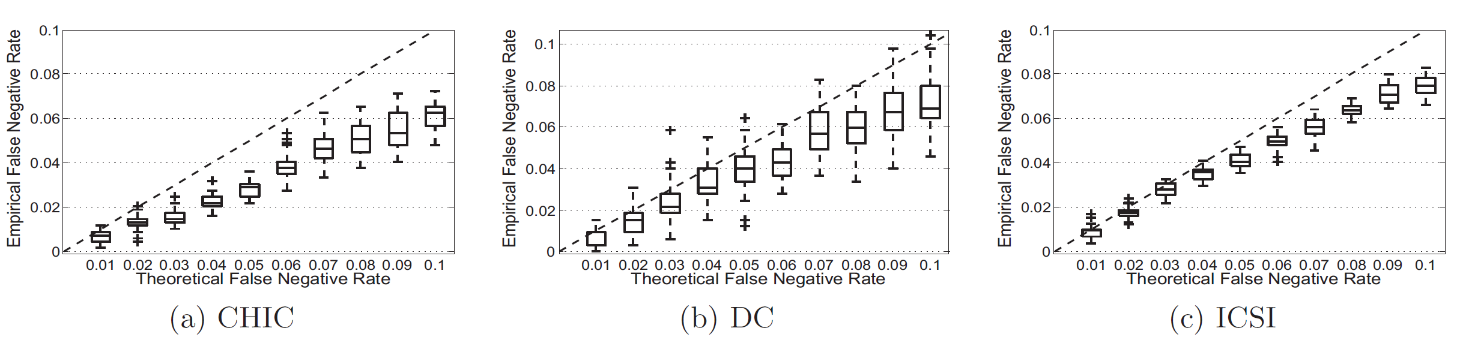
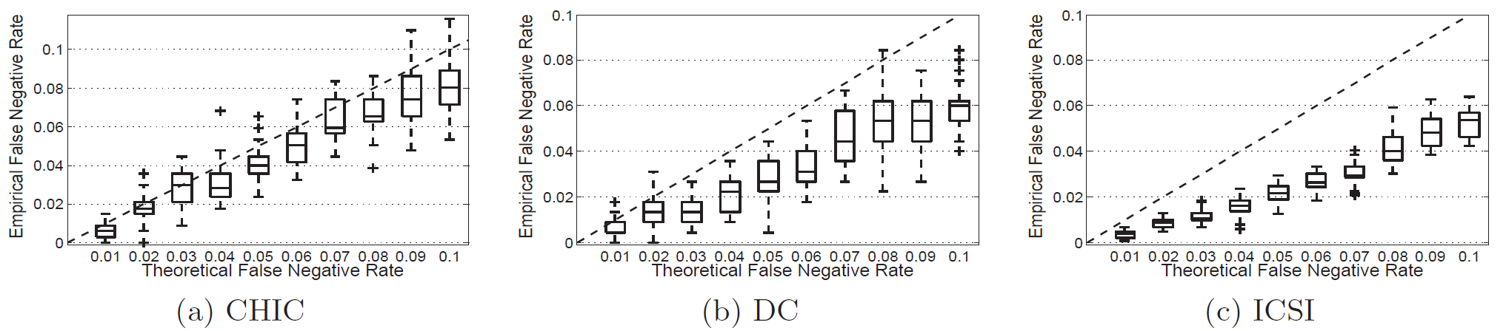
False Negative Rate
Our results show that the average FNR of PIE calculated from simulations is always less than the maximum desired FNR.
Empirical false negative rate vs. theoretical false negative rate when Tth = 40
Empirical false negative rate vs. theoretical false negative rate when Tth = 50
Notes:
For false negative rate, we first study the performance of PIE for controlling the false negative rate.
As the figures in the slides show, when the threshold of persistent items Tth is 40 or 50, the achieved average FNR of PIE is always less than the maximum desired FNR.

Slide 32
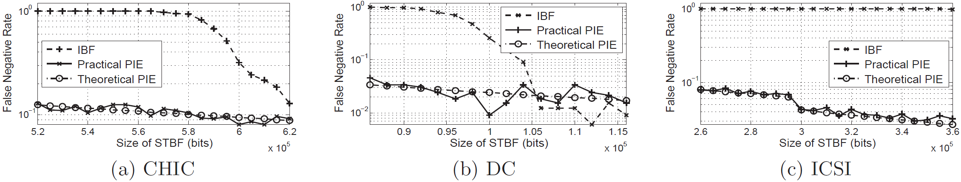
False Negative Rate (cont’)
Our results show that the average FNR of PIE is almost twice an order of magnitude smaller than the FNR of IBF.
False negative rate when Tth = 40
Notes:
Moreover, these figure in the slide show that the average FNR of PIE is nearly twice an order of magnitude smaller than that of IBF, and we can also see that the practical FNR matches well with theoretical FNR for PIE.

Slide 33
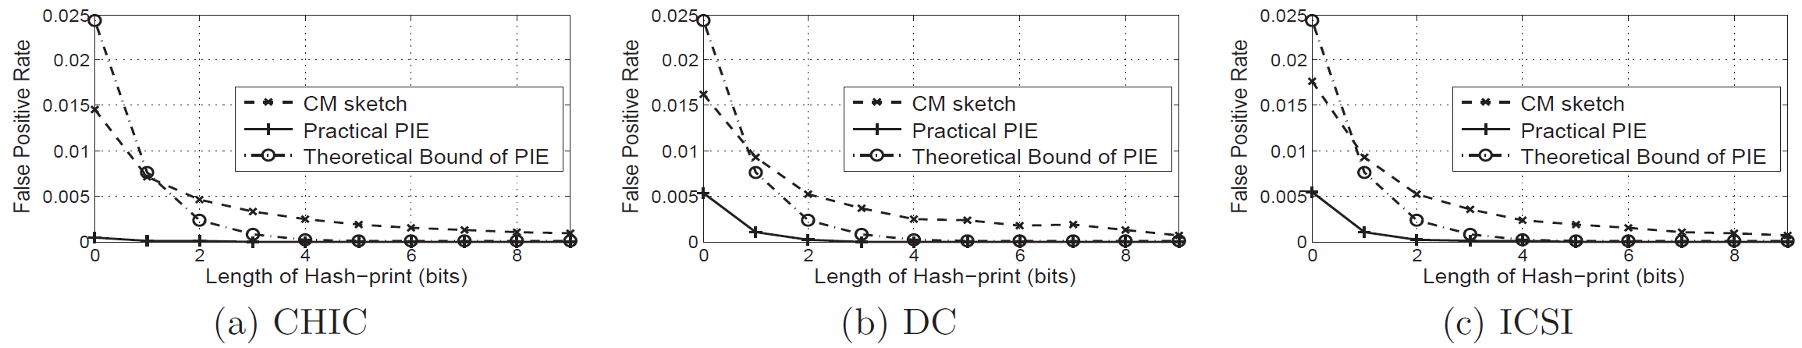
False Positive Rate
Our results show that FPR of PIE is at least 426.1 times less than the FPR of CM sketch.
False positive rate when Tth = 40
Notes:
For false positive rate, PIE performs much better than CM sketch. The results show that the performance gain is larger than 400 times.
Besides, we can see that our derived upper bound for FPR holds in these three figures.

Slide 34
Conclusion
Propose the notion of persistent item and define the problem of persistent items identification
Propose the Space-Time Bloom Filter data structure for persistent items identification
Analyze the False Negative Rate and False Positive Rate of PIE, and study parameter optimization
Conduct numerical evaluations based on real traces to validate the performance of PIE
Notes:
Here we conclude the paper as follows.
First, we propose the notion of persistent item and define the problem of persistent items identification.
Then, we propose the STBF data structure.
Third, we analyze the FNR and FPR, as well as the parameter optimization for FNR.
Finally, we conduct numerical evaluations based on real traces to validate the performance of PIE.

Slide 35



Notes:
That’s all. Thank you. Any questions?

